Slide 1
Face Replacement
Zhengxuan Wu, Yangyang Zhou
(Option 2)

Slide 2
Procedure
Face Detection On Pictures
Landmark Detection
Face TPS Morphing
Masking
Blending
Motion Compensation
Iterating Steps For Video
Happy Xmas!

Slide 3
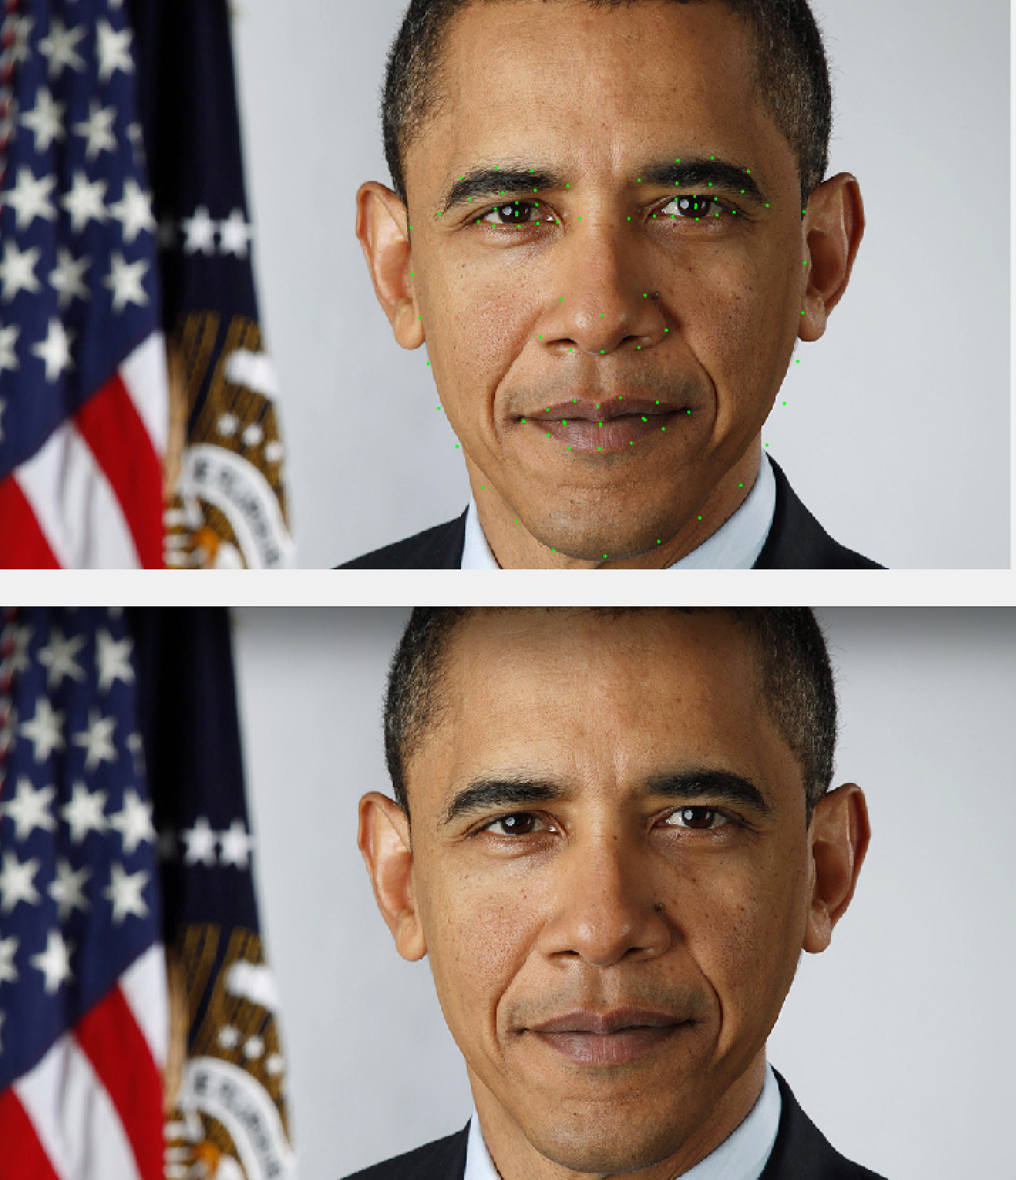
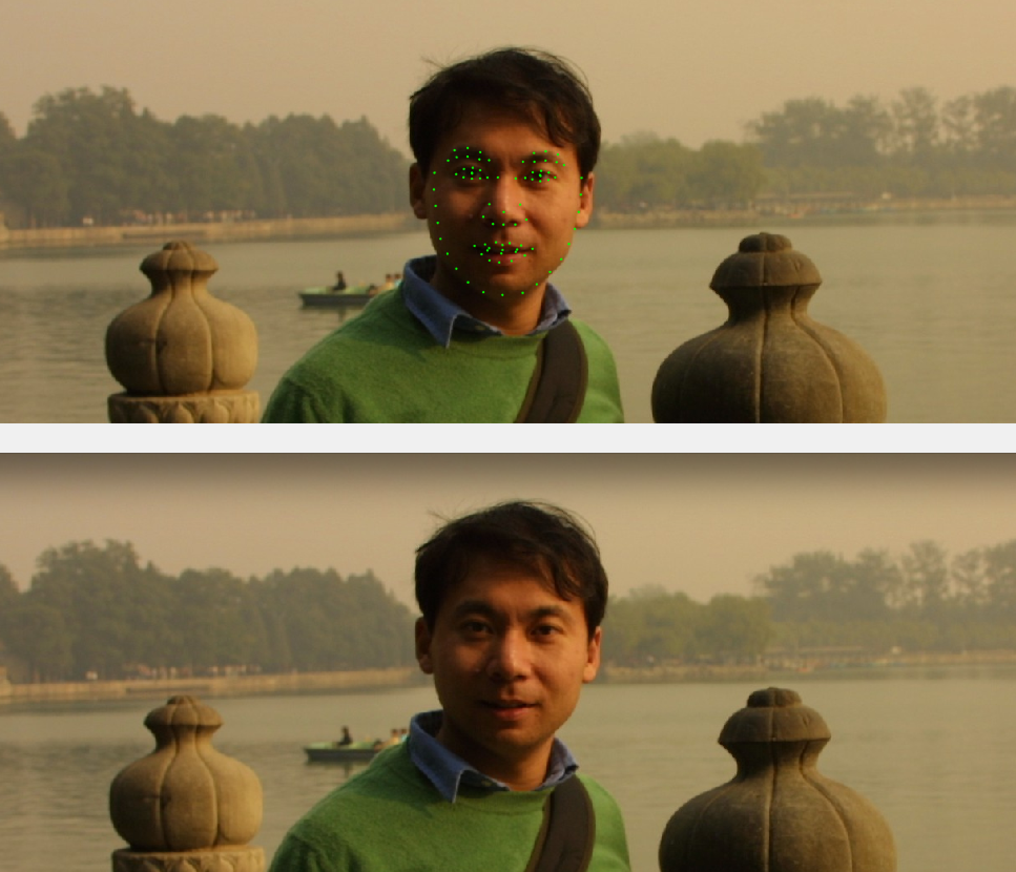
Face Detection & Landmark

Slide 4
Face Detection & Landmark
Two Methods Are Adopted And Compared
Facepp
Face Detection, Pose Estimation and Landmark Localization in the Wild (X. Zhu, D. Ramanan)
Facepp Are Used For Reasons
Quicker
DL Method Are Used For Higher Accuracy
More Concise Landmark Points (88 pts are used)

Slide 5
Face TPS Morphing
TPS Morphing based on Landmarks
Adopted From Project 2

Slide 6



Face TPS Morphing

Slide 7

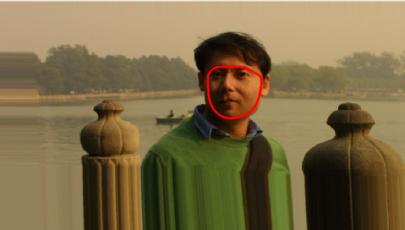
Masking
Mask has been generated based on the outside landmark points
Used Color Based Face Detection To Generate Face Region Mask (RGB to YIQ Method)

Slide 8
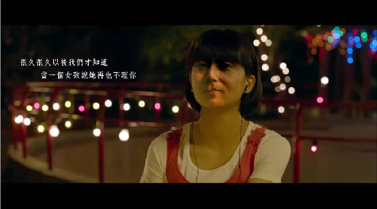
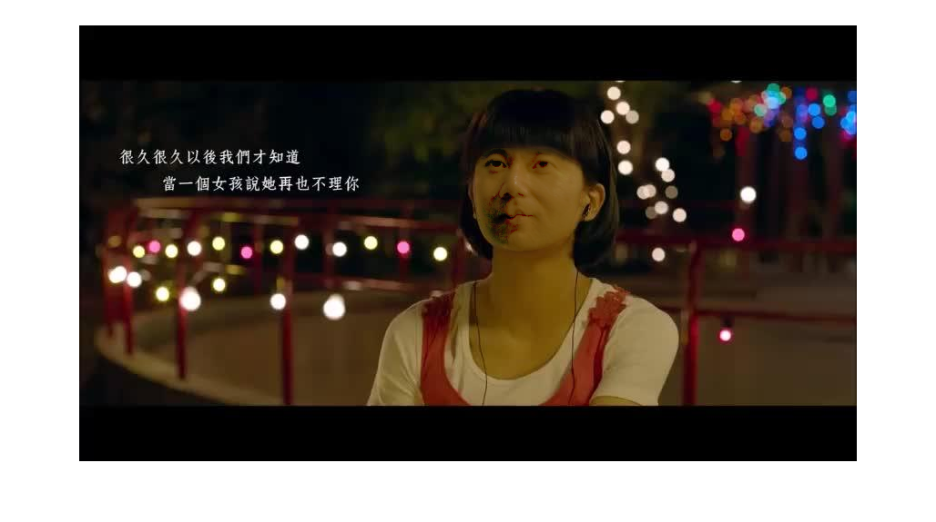
Blending
Poisson blending added
equalization with histogram
replacement face
Notes:
Here is the original replacement face of professor.
Notice that left part of the face is quite dark. That is quite challenging for us to achieve the vision result.
Initially we just try simple cross-dissolved method as the project 2. Unluckily, the result is totally unacceptable.
And, then, we applies

Slide 9
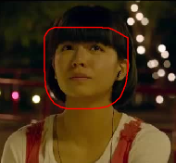
Poisson Blending
Generally Poisson blending:
solves shadow problem
improves skin texture
adjusting intensity and contrast
But leaves dark shadow on eye area
References: http://www.mathworks.com/matlabcentral/fileexchange/45799-poisson image-editing
Target area for blending
Area larger than the mask for color editing
Notes:
solves shadow problem on the original replacement face
improves skin texture, making it more similar as the target face in video

Slide 10
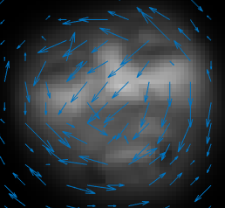
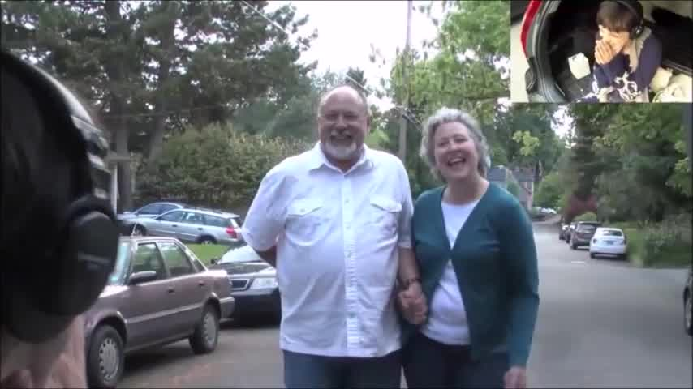
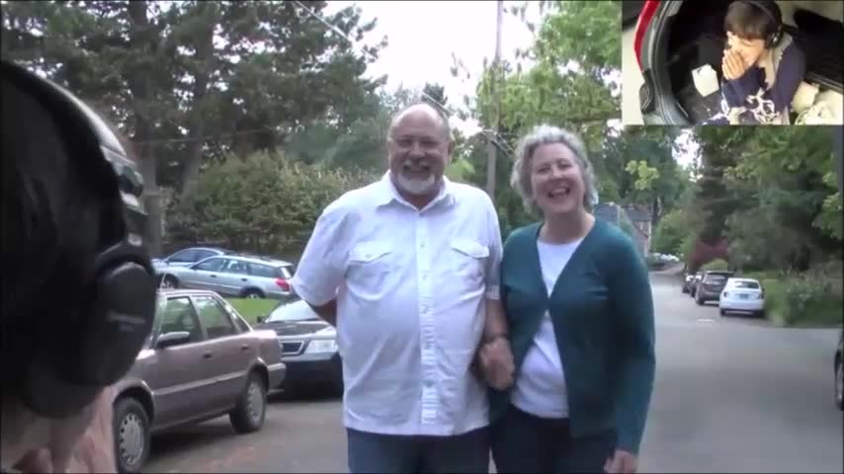
Motion Compensation
Motion vectors are calculated.
Future application on landmark points.

